Slide 1


Lecture 2-5 BPEL Case Studies Reading: Text Sections 8.2 and 8.3
CSE446 / CSE598 Software Integration and Engineering
Unit 2 Software Development by Composition and Integration
Dr. Yinong Chen

Slide 2
Case Study, also read Text Section 8.2.5
Source: Matjaz B., Juric, et al., Business Process Execution Language for Web Services BPEL and BPEL4WS, Packt Publishing; 2nd edition Jan 30, 2006.
Design a BPEL Process for a company’s travel request, which interacts with the following services:
Client: Access the BPEL process as a Web service
Employee Travel Status Web service: provides the regulations on travel;
Two airlines companies: are used for requesting ticket prices
More case studies online and in YouTube video:
Last slide in this lecture

Slide 3
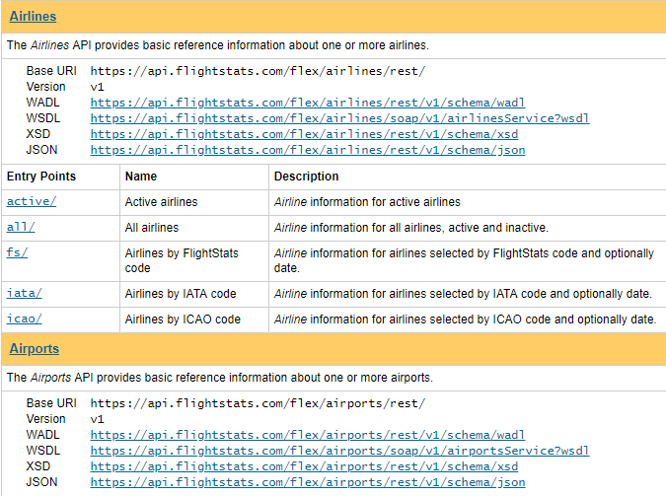
Where to Find Airlines Services? E.g., FlightStats Web Services
https://developer.flightstats.com/api-docs

Slide 4
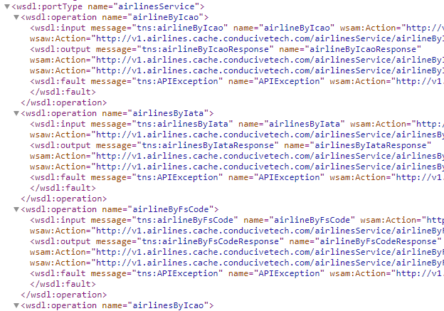
WSDL File
https://en.wikipedia.org/wiki/List_of_airline_codes
https://en.wikipedia.org/wiki/IATA_airport_code

Slide 5
Case Study Diagram
BPEL Process for Business Travels
portType
Employee
Travel
Status Web
Service
Client
2. Request
<<receive>>
Receive initial data from client
1. Request
3. Reply
6. Reply
<<invoke(sync)>>
Retrieve the employee
Travel status
<<invoke/receive(sync)>>
Get plane ticket offer
From American Airlines
<<invoke/receive(sync)>>
Get plane ticket offer
From Delta Airlines
4.1. Invoke
America
Airlines
Web
Services
[American.price
<= Delta.price]
[American.price
> Delta.price]
5.1.
Callback
portType
<<assign>>
Select the American
Airlines ticket
<<assign>>
Select the Delta
Airlines ticket
5.2.
Callback
Delta
Airlines
Web
Services
<<rely>>
Return the best
offer
4.2. Invoke

Slide 6
Employee Travel Status WS (Synchronous)
WSDL
Employee
Travel
Status
Web Services
EmployeeTravelStatusRequestMessage
Employee Travel
StatusPT:
EmployeeTravelStatus operation
EmployeeTravelStatusResponseMessage
in WSDL
<portType name="EmployeeTravelStatusPT">
<operation name= "EmployeeTravelStatus">
<input message= "tns : EmployeeTravelStatusRequestMessage" />
<output message= "tns: EmployeeTravelStatusResponseMessage" />
</operation>
</portType>

Slide 7
Case Study Diagram
BPEL Process for Business Travels
portType
Employee
Travel
Status Web
Service
Client
2. Request
<<receive>>
Receive initial data from client
1. Request
3. Reply
6. Reply
<<invoke(sync)>>
Retrieve the employee
Travel status
<<invoke/receive(sync)>>
Get plane ticket offer
From American Airlines
<<invoke/receive(sync)>>
Get plane ticket offer
From Delta Airlines
4.1. Invoke
America
Airlines
Web
Services
[American.price
<= Delta.price]
[American.price
> Delta.price]
5.1.
Callback
portType
<<assign>>
Select the American
Airlines ticket
<<assign>>
Select the Delta
Airlines ticket
5.2.
Callback
Delta
Airlines
Web
Services
<<rely>>
Return the best
offer
4.2. Invoke

Slide 8
Airline Web Services (Asynchronous)
WSDL
BPEL
Process’s WSDL
Airline
Web
Services
FlightTicketRequestMessage
FlightAvailabilityPT:
FlightAvailability operation
FlightCallbackPT:
FlightTicketCallback operation
TravelResponseMessage
<portType name="FlightCallbackPT">
<operation name= "FlightTicketCallback">
<input message=
"tns : TravelResponseMessage"/>
</operation>
</portType>
in WSDL
<portType name="FlightAvailabilityPT">
<operation name= "FlightAvailability">
<input message=
"tns : FlightTicketRequestMessage"/>
</operation>
</portType>
in WSDL

Slide 9
Case Study Diagram
BPEL Process for Business Travels
portType
Employee
Travel
Status Web
Service
Client
2. Request
<<receive>>
Receive initial data from client
1. Request
3. Reply
6. Reply
<<invoke(sync)>>
Retrieve the employee
Travel status
<<invoke/receive(sync)>>
Get plane ticket offer
From American Airlines
<<invoke/receive(sync)>>
Get plane ticket offer
From Delta Airlines
4.1. Invoke
America
Airlines
Web
Services
[American.price
<= Delta.price]
[American.price
> Delta.price]
5.1.
Callback
portType
<<assign>>
Select the American
Airlines ticket
<<assign>>
Select the Delta
Airlines ticket
5.2.
Callback
Delta
Airlines
Web
Services
<<rely>>
Return the best
offer
4.2. Invoke

Slide 10
WSDL of the BPEL Process
BPEL
Process’s
WSDL
Client
TravelRequestMessage
TravelApprovalPT
TravelApproval operation
TravelResponseMessage
FlightCallbackPT:
FlightTicketCallback operation
<portType name="TravelApprovalPT">
<operation name= "TravelApproval">
<input message=
"tns: TravelRequestMessage"/>
<output message=
"tns: TravelResponseMessage"/>
</operation>
</portType>
in WSDL
<portType name="FlightCallbackPT">
<operation name= FlightTicketCallback>
<input message=
"tns: TravelResponseMessage"/>
</operation>
</portType>
in WSDL

Slide 11
Case Study Diagram
BPEL Process for Business Travels
portType
Employee
Travel
Status Web
Service
Client
2. Request
<<receive>>
Receive initial data from client
1. Request
3. Reply
6. Reply
<<invoke(sync)>>
Retrieve the employee
Travel status
<<invoke/receive(sync)>>
Get plane ticket offer
From American Airlines
<<invoke/receive(sync)>>
Get plane ticket offer
From Delta Airlines
4.1. Invoke
America
Airlines
Web
Services
[American.price
<= Delta.price]
[American.price
> Delta.price]
5.1.
Callback
portType
<<assign>>
Select the American
Airlines ticket
<<assign>>
Select the Delta
Airlines ticket
5.2.
Callback
Delta
Airlines
Web
Services
<<rely>>
Return the best
offer
4.2. Invoke

Slide 12
BPEL Process Definition
Workflow-First
BPEL process definition specifies the workflow / order of activities to be performed within a business process.
As a WS, a BPEL process typically waits, using <receive> activity, for an incoming message, which is the client request;
Then a series of activities occur, either sequentially or in parallel. These activities include:
<invoke> operations on other web services
<receive> results from other web services
Conditional branching, which influences the flow of the business process
Looping
Fault handling
Waiting for certain events to occur

Slide 13
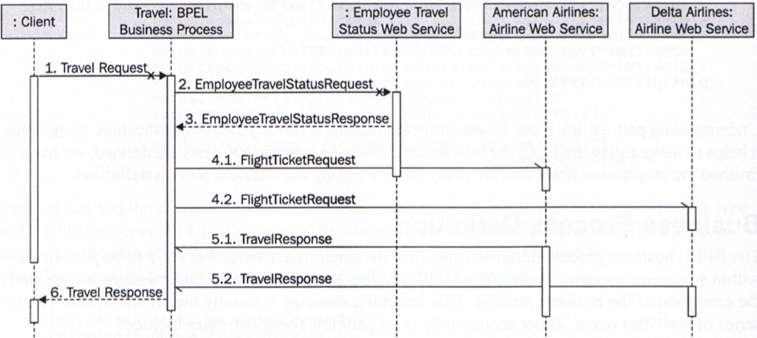
Process Diagram with Synchronous Request
Asynchronous
Asynchronous
Synchronous
Synchronous
Asynchronous
Asynchronous

Slide 14
Partner Link Types (LT) of the Process
For each partner of the Process, we need to define a partner link type in the BPEL process’s WSDL:
travelLT: used to describe the interaction between the BPEL process and the client. This interaction is synchronous.
employeeLT: used to describe the interaction between the BPEL process and the Employee Travel Status. This interaction is synchronous too.
flightLT: used to describe the interaction between the BPEL process and the Airline web services. This interaction is asynchronous; We assume airlines have the same type of services. If different, need different types.

Slide 15
Process’s Partner Link Types Definition in Process’s WSDL
Extended WSDL element
Standard WSDL element
<plnk:partnerLinkType name= "travelLT">
<plnk:role name= "travelService">
<plnk:portType name="tns:TravelApprovalPT" />
</plnk:role>
</plnk:partnerLinkType>
<plnk:partnerLinkType name= "employeeLT">
<plnk:role name= "employeeTravelStatusService">
<plnk:portType name="tns: employeeTravelStatusServicePT" />
</plnk:role>
</plnk:partnerLinkType>
<plnk:partnerLinkType name= "flightLT">
<plnk:role name= "airlineService">
<plnk:portType name="tns:flightAvailabilityPT" />
</plnk:role>
<plnk:role name= "airlineCustomer">
<plnk:portType name="tns:flightCallbackPT" />
</plnk:role>
</plnk:partnerLinkType>
travelLT
(sync)
Synchronous: one role
Synchronous: one role
employeeLT
(sync)
Asynchronous: two roles
flightLT
(async)

Slide 16
BPEL Process Definition Overview
<process name="Travel" ... >
<partnerLinks>
<!-- The declaration of partner links -->
</partnerLinks>
<variables>
<!-- The declaration of variables -->
</variables>
<sequence>
<!-- The definition of the BPEL process main body -->
</sequence>
</process>

Slide 17
The Root Element "process"
<process name="Travel"
targetNameSpace="http://packtpub.com/bpel/travel/" xmlns=http://schemas.xmlSoap.org/ws/2003/03/business-process/
xmlns:bpws= "http://schemas.xmlsoap.org/ ws/2003/03/business-process!"
xmlns:trv="http://packtpub.com/bpel/travel/"
xmlns:emp="http://packtpub.com/service/employee/"
xmlns:aln="http://packtpub.com/Service/airline/" >

Slide 18
partnerLinks of the BPEL Process
portType included in
There is one portType defined between the two partners. Thus, sync communication is applied
<partnerLinks>
<partnerLink name="client"
partnerLinkType="trv:travelLT"
myRole="travelService"/>
<partnerLink name="employeeTravelStatus"
partnerLinkType="emp:employeeLT"
partnerRole="employeeTravelStatusService"/>
<partnerLink name="AmericanAirIines"
partnerLinkType = "aln:flightLT"
myRole="airlineCustomer"
partnerRole="airlineService"/>
<partnerLink name="DeltaAirIines"
partnerLinkType = "aln:flightLT"
myRole="airlineCustomer"
partnerRole="airlineService"/>
</partnerLinks>
One role
One role
Two roles
Two roles
There are two portTypes defined between the two partners: One is from BPEL to airlines and the other is from airlines to BPEL
There are two portTypes defined between the two partners: One is from BPEL to airlines, and the other is from airlines to BPEL, and thus, async communication will be applied.
Two roles
Two roles
portType included in
portType included in

Slide 19
Variables
<variables>
<!-- input for this process -->
<variable name="TravelRequest" messageType="trv:TravelRequestMessage"/>
<!-- input for the Employee Travel Status web service -->
<variable name="EmployeeTravelStatusRequest"
messageType="emp: EmployeeTravel StatusRequestMessage"/>
<!-- output from the Employee Travel Status web service
<variable name="EmployeeTravelStatusResponse"
messageType="emp:EmployeeTravelStatusResponseMessage"/>
<!-- input for American and Delta web services -->
<variable name="FlightDetails" messageType="aln:FlightTicketRequestMessage"/>
<!-- output from American Airlines -->
<variable name="FlightResponseAA" messageType="aln:Travel ResponSeMeSSage"/>
<!-- output from Delta Airlines --->
<variable name="FlightResponseDA" messageType="aln:Travel ResponseMesSage"/>
<!-- output from BPEL process -->
<variable name="TravelResponse" messageType="aln:TravelResponseMessage"/>
</variables>

Slide 20
The Main Body of the Process
<sequence>
<!-- Receive the initial request for from client -->
<receive partnerLink="client"
portType="trv:TravelApprovalPT"
operation="TravelApproval"
variable="TravelRequest"
createlnstance="yes" />
<!-- Prepare input for the Employee Travel Status WS -->
<assign>
<copy>
<from variable="TravelRequest" part="employee"/>
<to variable="EmployeeTravelStatusRequest" part="employee"/>
</copy>
</assign>
1
2

Slide 21
In Main Body: Invoke Employee Travel Status WS
<!-- synchronously invoke Employee Travel Status Web Service -->
<invoke partnerLink="employeeTravelStatus" portType="emp:EmployeeTravelStatusPT"
operation="EmployeeTravelStatus"
inputvariable="EmployeeTravelStatusRequest" outputvariable="EmployeeTravelStatusResponse"/>
3

Slide 22
In Main Body: Prepare the Input
<!-- Prepare the input for invoking airlines -->
<assign>
<copy>
<from variable="TravelRequest" part="flightData"/>
<to variable="FlightDetails" part="flightData"/>
</copy>
<copy>
<from variable="EmployeeTravelstatusResponse"
part="travelClass"/>
<to variable="FlightDetails" part="travelClass"/>
</copy>
</assign>
4
4.1
Part 1: Date and time
4.2
Part 2:
Business class

Slide 23
In Main Body: Invoke the Airlines
<!-- Make concurrent invocation to AA and DA -->
<flow>
<sequence>
<!-- Async invoke of the AA WS -->
<invoke partnerLink="AmericanAirlines"
portType="aln:FlightAvailabilityPT"
operation="FlightAvailability"
inputvariable= "FlightDetails" />
<receive partnerLink="AmericanAirlines"
portType="aln:FlightCallbackPT"
operation="FlightTicketCallback"
variable="FlightResponseAA" />
</sequence>
5
5.1
<sequence>
<invoke partnerLink="DeltaAirlines"
portType="aln:FlightAvailabilityPT"
operation="FlightAvailability"
inputvariable="FlightDetails" />
<receive partnerLink="DeltaAirlines"
portType="aln:FlightCallbackPT"
operation="FlightTicketCallback"
variable="FlightResponseDA" />
</sequence>
</flow>
5.2

Slide 24
In Main Body: Selection the Best Price
<!-- select the best offer and construct the Travel Response -->
<switch>
<case condition="bpws:getVariableData(‘FlightResponseAA’,
‘confirmationData’ , ‘/confirmationData/aln:Price’)
&lt; = bpws:getVariableData(‘FlightResponseDA’,
‘confirmationData’, ‘/confirmatlonData/aln:Price’)">
<!-- Select American Airlines -->
<assign>
<copy>
<from variable=
"FightResponseAA" />
<to variable=
"TravelResponse" />
</copy>
</assign>
6
<otherwise>
<!-- select Delta Airlines -->
<assign>
<copy>
<from variable=
"FlightResponseDA" />
<to variable=
"TravelResponse" />
</copy>
</assign>
</otherwise>
</switch>

Slide 25
In Main Body: Send the Response to the Client
<!-- send a response to the client -->
<reply partnerLink="Client"
portType="trv:TravelApprovalPT"
operation="TravelApproval"
variable="TravelResponse"/>
</sequence>
</process>
7

Slide 26
Activities forming synchronous and asynchronous two-way communication
Synchronous
Client
Server
<invoke>
…
<receive>
…
<reply>
Asynchronous
Client
Server
<invoke>
…
<receive>
<receive>
…
<invoke>

Slide 27
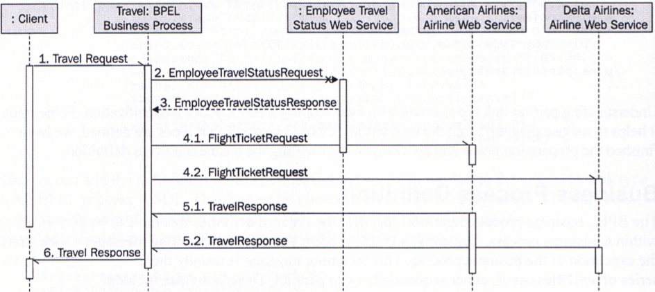
Process Diagram with Asynchronous Request
The problem with the combination of synchronous and asynchronous is that the client may have to wait an excessively long period of time.
We may want to make the following changes.
Synchronous
Asynchronous
Asynchronous

Slide 28
Revise WSDL between Client BPEL Process
BPEL
Process
Client
TravelRequestMessage
TravelApprovalPT
TravelApproval operation
ClientCallbackPT
ClientCallback operation
TravelResponseMessage
2
1
<portType name="TravelApprovalPT">
<operation name= TravelApproval>
<input message=
"tns:TravelRequestMessage"/>
<output message=
"tns : TravelResponseMessage"/>
</operation>
</portType>
<portType name="TravelApprovalPT">
<operation name= TravelApproval>
<input message=
"aln: TravelResponseMessage"/>
</operation>
</portType>

Slide 29
Revise the Partner Link Types and Link in WSDL
<plnk:partnerLinkType name= "travelLT">
<plnk:role name= "travelService">
<plnk:portType name="tns:TravelApprovalPT" />
</plnk:role>
<plnk:role name= "travelServiceCustomer">
<plnk:portType name="tns:clientCallbackPT" />
</plnk:role>
</plnk:partnerLinkType>
travelLT
3
Add this role

Slide 30
Revise the Process Definition
4
<partnerLinks>
<partnerLink name="client"
partnerLinkType="trv:travelLT"
myRole="travelService"/>
partnerRole = "travelServiceCustomer"/>
…
</partnerLinks>
In the
Partner
link
definition
5
<!– Make a callback to the client -->
<invoke partnerLinl="client"
portTypeLink="trv:ClientCallbackPT"
operation="ClientCallback"
inputvariable = "TravelResponse"/>
…
</ sequence
</process>
In the
processing
part

Slide 31
Invoking Real Web Service: Text 8.2.5
BPEL Process
Client
USZip
Service
1
1. Request
2
portType
2. Request
<<receive>>
Receive initial data from client
portType
<<invoke/receive(sync)>>
Retrieve the address info from USZip Service
portType
3
6
3. Reply
6. Callback
<<assign>>
Select the zip code from the result
<<invoke/receive(sync)>>
Retrieve the movie theatre information from Movie Info Service
Movie
Info
Service
4
4. Request
portType
<<assign>>
Select the theatre list from result
<<invoke>>
Return the Movie Info to Client callback
5
5. Reply

Slide 32
Correlations for Asynchronous Calls
Correlations and Stateful Service
BPEL Development Frameworks
Oracle SOA Suite: BPEL Process Manager and JDeveloper Designer
http://www.oracle.com/technology/software/tech/webservices/index.html http://www.oracle.com/technology/software/products/jdev/index.html http://www.oracle.com/technetwork/articles/soa/index-095969.html
BPMN and Oracle BPM Studio
Microsoft BizTalk
http://www.microsoft.com/BizTalk

Slide 33
Structure of a BPEL Process
<process ...>
<partners> ... </partners>
<!-- Web services the process interacts with -->
<variables> ... </variables>
<!– Global variables for storing data used by the process -->
<correlations> ... </correlations>
<!– Used to support stateful interactions -->
<faultHandlers> ... </faultHandlers>
<!–Alternate execution path to deal with faulty conditions -->
<compensationHandlers> ... </compensationHandlers>
<!–Code to execute when “undoing” an action -->
(activities)*
<!– What the process actually does -->
</process>

Slide 34
Stateless versus Stateful Web Services
Web services are normally stateless. Each call is considered to be from a different client.
An asynchronous service can be implemented in two different ways:
A one-way call to initiate the service, and a second call to retrieve the result;
A one-way call to initiate the service, and a callback to send the result back to the client.
In both cases, the service needs to correlate the two calls, so that the result is delivered to the right caller, because
There can be multiple clients calling the service, and
Each client can call the service multiple times.

Slide 35
Different Solutions for Stateful Services
Windows Communication Foundation (WCF)
PerCall: one instance per call (stateless)
PerSession: one instance per session
Single: one instance per application (singleton)
BizTalk: singleton instance
The service supporting singleton instance will need to
share certain information among all users, and thus
correlate between the requests within the instance created before.
Maintain a list of proxies pointing to the instance;
Maintain a list of accounts and states related to each user account if re-login is allowed;
Recognize the proxy (session information) and user account (login) when an invocation is requested.
A design pattern

Slide 36
BPEL State and Correlation
BPEL process can model both types of interactions:
Simple stateless interactions
Stateful, long running (persistent), and asynchronous interactions.
<correlations> provides support for the latter:
<correlations> represents the data that is used for maintaining the state of the interaction (a “conversation”).
At the process side of the interaction, <correlations> allows incoming messages to reach the right process instance.
What are correlations?
A set of shared business data fields that capture the state of the interaction (“correlating business data”). For example: a “purchase order number”, a “customer id”, etc.;
Each correlation is initialized once;
Its values do not change in the course of the interaction.

Slide 37
Multiple Correlations
Multiple Clients
A
M1
B
M2
BPEL
WS
C
M1
M2
D

Slide 38
Defining Correlations
<correlation set="..." properties="..."/>
A correlation defines a named set of properties, which are defined as WSDL extensibility elements.
A property is “mapped” to a field in a WSDL message type.
The property can thus be found in the messages actually exchanged.
Typically, a property will be mapped to several different message types and carried on in many interactions, across operations and portTypes

Slide 39
Use Correlations in receive and invoke
<receive partner= "client" operation="..." portType="ClientPT" container="...">
<correlations>
<correlation set = "Order" initiate = "yes"/>
</correlations>
</receive>
<invoke partnerLink="Client" portType="ClientPT"
operation="PurchaseResponse" inputVariable="PO">
<correlations>
<correlation set="Order" initiate="no" />
</correlations>
</invoke>
An input or output operation identifies which correlation applies to the messages received or sent.
That correlation will be used to assure that the message is related to the appropriate stateful interaction.

Slide 40
Correlation “initiate” Attribute Values
When the initiate attribute is set to "yes":
The related activity must attempt to initiate the correlation element.
If the correlation element is already initiated, an error bpel:correlationViolation must be thrown.
When the initiate attribute is set to "join":
The related activity must attempt to initiate the correlation element, if the correlation element is not yet initiated.
If the correlation element is already initiated and the correlation consistency constraint is violated, an error bpel:correlationViolation must be thrown.
When the initiate attribute is set to "no" or is not explicitly set, the related activity must not attempt to initiate the correlation element.
If the correlation element has not been previously initiated, an error bpel:correlationViolation must be thrown.
If the correlation element is already initiated and the correlation consistency constraint is violated, an error bpel:correlationViolation MUST be thrown

Slide 41
Correlation Example
http://docs.oasis-open.org/wsbpel/2.0/wsbpel-v2.0.html
Buyer’s
BPEL
Process
SP:PurchasingPT
Seller’s
BPEL
Process
SP:BuyerPT

Slide 42
<invoke partnerLink="Seller" portType="SP:PurchasingPT"
operation="PurchaseRequest" variable="PO">
<correlations>
<correlation set="PurchaseOrder" initiate="yes" />
</correlations>
</invoke>
...
<pick>
<onMessage partnerLink="Seller" portType="SP:BuyerPT"
operation="PurchaseResponse" variable="POResponse">
<correlations>
<correlation set="PurchaseOrder" initiate="no" />
<correlation set="Invoice" initiate="yes" />
</correlations>
... <!-- handle the response message -->
</onMessage>
<onMessage partnerLink="Seller" portType="SP:BuyerPT"
operation="PurchaseReject" variable="POReject">
<correlations>
<correlation set="PurchaseOrder" initiate="no" />
</correlations>
... <!-- handle the reject message -->
</onMessage>
</pick>
Buyer’s
BPEL
Process
<pick> executes the activity associated with first arrival of “onMessage”: event-driven

Slide 43
Correlation Element Example (contd.)
<receive partnerLink="Buyer" portType="SP:PurchasingPT"
operation="PurchaseRequest" variable="PO">
<correlations>
<correlation set="PurchaseOrder" initiate="yes" />
</correlations>
</receive>
<! -- ... Process … switch … -->
<invoke partnerLink="Buyer" portType="SP:BuyerPT"
operation="PurchaseResponse" inputVariable="POResponse">
<correlations>
<correlation set="PurchaseOrder" initiate="no" />
<correlation set="Invoice" initiate="yes" />
</correlations>
</invoke>
Seller’s
BPEL
Process
The 1st property is used to correlate activities
<invoke partnerLink="Buyer" portType="SP:BuyerPT"
operation="PurchaseReject" inputVariable="POReject">
<correlations>
<correlation set="PurchaseOrder" initiate="no" />
</correlations>
</invoke>

Slide 44
OASIS WS-BPEL 2.0
http://docs.oasis-open.org/wsbpel/2.0/wsbpel-v2.0.html
<receive>
<reply>
<invoke>
<assign>
<throw>
<exit>
<wait>
<empty>
<sequence>
<if>
<while>
<repeatUntil>
<forEach>
<pick>
<flow>
<scope>
<compensate>
<compensateScope>
<rethrow>
<validate>
<extensionActivity>

Slide 45
Summary of BPEL
Overview of Application/WS Composition languages
BPEL process defines the order of activities to be performed;
BPEL process defines a composite Web service;
BPEL process has a service interface, which uses WSDL with extensions
Case Study
Correlation
BPEL Process
(workflow)
BPEL WSDL
(interface)
BPEL-Defined
WSDL Extension
partnerLinkType
correlations

Slide 46
Case Study Examples and Tutorials
References
In textbook section 8.2.5, an example using real Web services (zip service and movie service), is given.
Oracle: SOA Suite Integration: Part 1: Building a Web Service: https://blogs.oracle.com/theshortenspot/soa-suite-integration:-part-1:-building-a-web-service
Oracle: SOA Suite Integration: Part 2: A basic BPEL process: https://blogs.oracle.com/theshortenspot/soa-suite-integration:-part-2:-a-basic-bpel-process
Salesforce using SOA Suite: https://www.youtube.com/watch?v=W870Zm9J_9s
YouTube Videos
https://www.youtube.com/watch?v=BAc7aTZCq7U
https://www.youtube.com/watch?v=Uq6qS454hdU
https://www.youtube.com/watch?v=qCxdmsM_FHs

